Slide 1
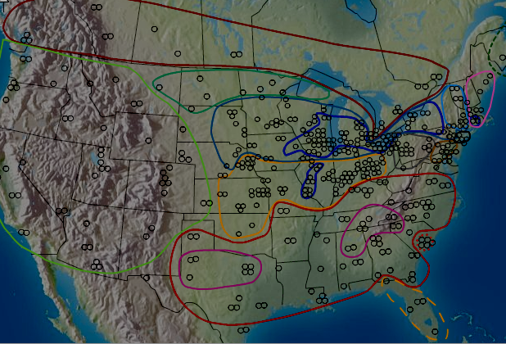
Enigmas of Uniformity
William Labov
University of Pennsylvania
NWAV 38 Ottawa 2009

Slide 2
Variation and invariance in the speech community.
The central dogma of sociolinguistics is the primacy of the speech community: the linguistic behavior of the individual can be understood only through the norms of the speech communities that he or she is a member of.
The linguistic faculty of the individual includes the capacity to distinguish the general pattern of the speech community from individual variation.
This pattern involves variables as well as constants along with the norms which control variation over a uniform structural configuration.
Notes:
Guy 1980, 2000

Slide 3
Invariance in the analysis of variation
The systematic study of variation begins with the finding of inherent variation in the realization of a linguistic variable: two alternate ways of saying the same thing.
The principle of accountability calls for the frequency with which the event occurs along with the frequency with which it does not occur.
This requires the definition of the variable—the outer envelope of variation--as a closed set of occurrences and non-occurrences.
The definition is invariant throughout the study of linguistic and social constraints on the variable.

Slide 4
Aspects of invariance across the speech community
Uniform patterns of variation
The uniform structural base for variation
Uniform directions of change
Uniform result of completed changes

Slide 5
The size of the speech community
The neighborhood
The metropolis
The dialect region
The nation state
The continent
The language

Slide 6
Enigmas of uniformity 1
The geographic unity of New York City

Slide 7
Percent [r] in rapid and anonymous study of three New York City department stores, 1962
Source: Labov 1966

Slide 8
Percent [r] in rapid and anonymous study of three New York City department stores, 1962 and 1986
Source: Labov 1966, Fowler 1986

Slide 9
Percent [r] in by age in Saks
Source: Labov 1966

Slide 10
Percent [r] in by age in Saks, 1962 and 1986
Source: Labov 1966, Fowler 1986

Slide 11
Percent [r] in by age in Macy’s
Source: Labov 1966

Slide 12
Percent [r] in by age in Macy’s, 1962 and 1986
Source: Labov 1966, Fowler 1986

Slide 13
(r) In NYC department stores by age and store
S = Saks
M = Macy’s
K = S. Klein

Slide 14
(r) In NYC Lower East Side by age and social class
UMC = upper middle class
LMC = lower middle class
WC = working class

Slide 15
Alignment of the Lower East and Department Store Studies

Slide 16
Enigmas of uniformity 2
The short-a split in Philadelphia

Slide 17
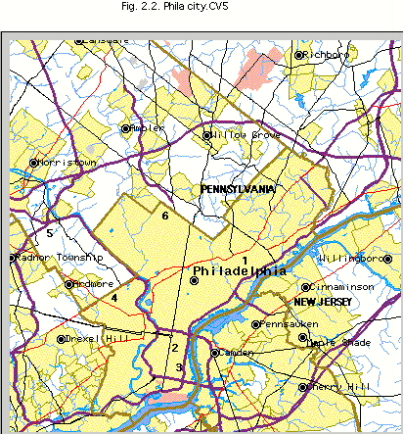
The Philadelphia Neighborhood Study [N=120]
Upper class Chestnut Hill
Nancy Drive King of Prussisa
WicketSt. Kensington
Mallow St. Overbrook
Clark St. So. Phila
Pitt St.: So. Phila

Slide 18
Syllable closing conditions for tensing of short-a in Philadelphia
mad, bad, glad only
p t tʃ k
b d dʒ g
m n ŋ
f s θ ʃ
v z ð ʒ

Slide 19
Tensing and laxing of short-a words before /d/ in spontaneous speech in the Philadelphia Neighborhood Study for 120 speakers from all social classes
TENSE LAX
bad 143 0
mad 73 0
glad 18 1
sad 0 14
dad 0 10

Slide 20
Environmental conditioning of fronting of Philadelphia short-a by social class [from Kroch 1995]

Slide 21
Enigmas of uniformity 3
The uniform rate of sound change in Philadelphia

Slide 22
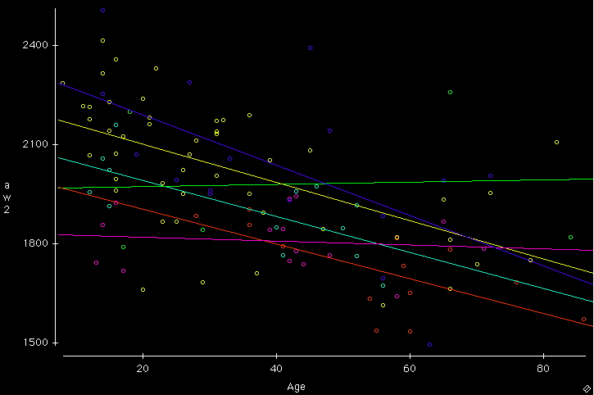

Fronting of /aw/ (F2) in out, south, mountain, downtown, etc. by age with partial regression lines for 6 socioeconomic groups in Philadelphia [N=112]

Slide 23
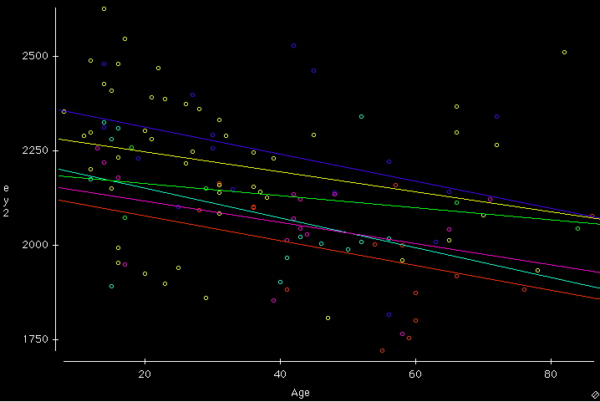
Fronting of /ey/ (F2) in closed syllables in made, pain, lake, etc. by age with partial regression lines for 6 socioeconomic groups in Philadelphia [N=112]

Slide 24
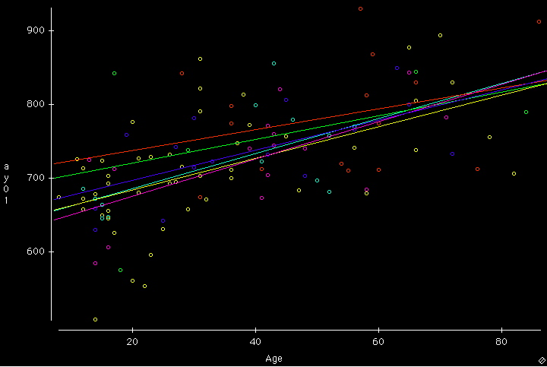
Raising of /ay/ before voiceless consonants in sight, bike, fight, etc. by age with partial regression lines for 6 socioeconomic groups in Philadelphia [N=112]

Slide 25
Enigmas of uniformity 4
The shift to r-pronunciation in the South

Slide 26
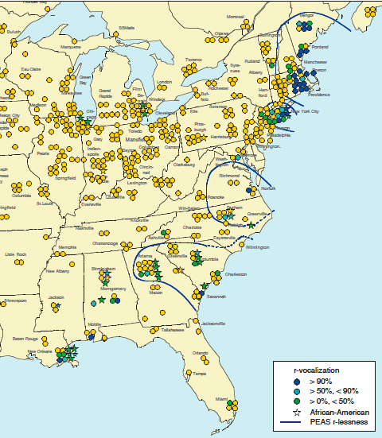
R-less* areas in the 1950s (Pronunciation of English in the Atlantic States - PEAS) compared to the 1990s (Atlas of North American English - ANAE)
________
* “R-less”
= “R-vocalization”
= not pronouncing R after a vowel, e.g. “pahk the cah”

Slide 27
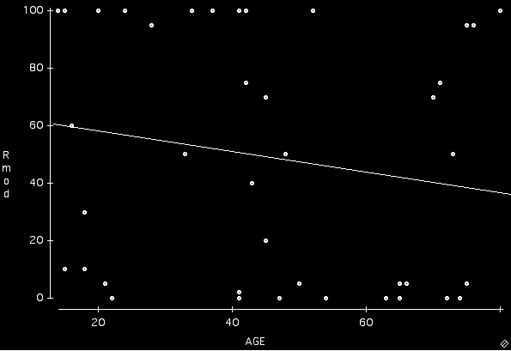
Percent /r/ in NYC and New England by age (ANAE, 1990s)
% /r/ pronounced

Slide 28
Percent positive response to (r) on two-choice subjective reaction test in New York City in the 1960s

Slide 29
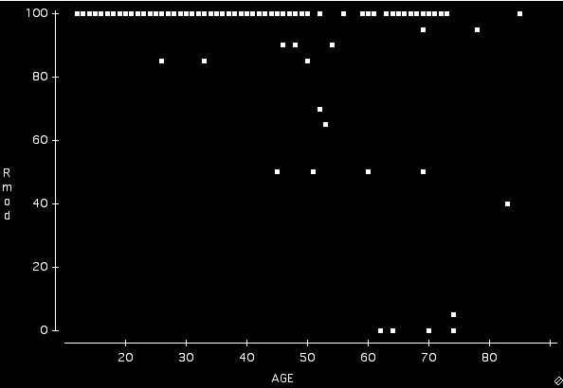
Percent /r/ among Southern Whites by age (ANAE, 1990s)
% /r/ pronounced
100% ‘r’- pronouncing speakers

Slide 30
R-less* areas in the 1950s (Pronunciation of English in the Atlantic States - PEAS) compared to the 1990s (Atlas of North American English - ANAE)
________
* “R-less”
= “R-vocalization”
= not pronouncing R after a vowel, e.g. “pahk the cah”

Slide 31
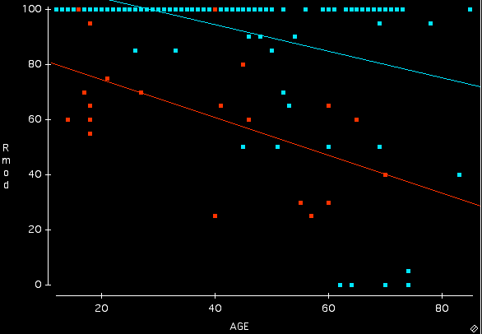
Percent /r/ in the South by age by age and race (ANAE, 1990s)
% /r/ pronounced
Black
White

Slide 32
Enigmas of uniformity 5
The uniformity of the Northern Cities Shift in the Inland North

Slide 33
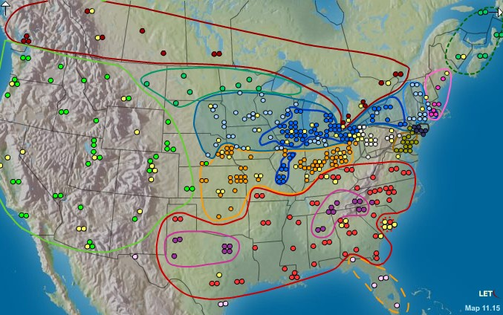
ANAE
The Atlas of North American English
William Labov, Sharon Ash and Charles Boberg
Berlin: Mouton, 2006

Slide 34
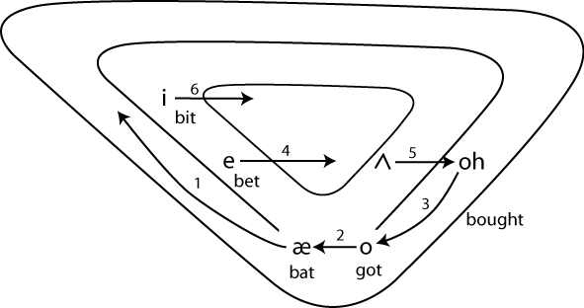
The Northern Cities Shift

Slide 35
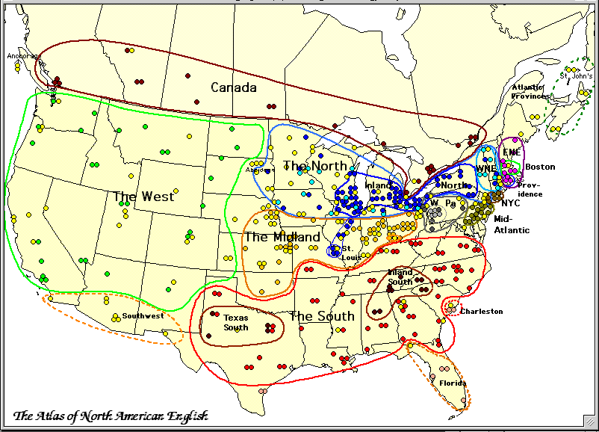
The Dialects of North American English

Slide 36
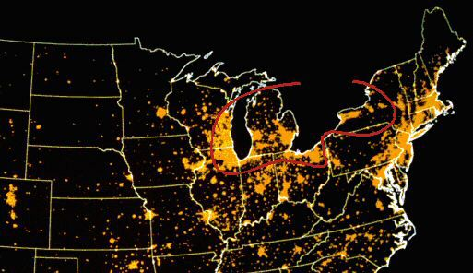
U.S. at Night
The Inland North
Grand Rapids
Milwaukee
Syracuse
Chicago
Rochester
Flint
Buffalo
Detroit
Kenoshat
Cleveland
Joliet
Omaha
Toledo
Columbus
CIncinnati
Indianapolis
Kansas City

Slide 37
The scope of the Northern Cities Shift
Area affected: 88,000 square miles
Population involved: 34,000,000

Slide 38
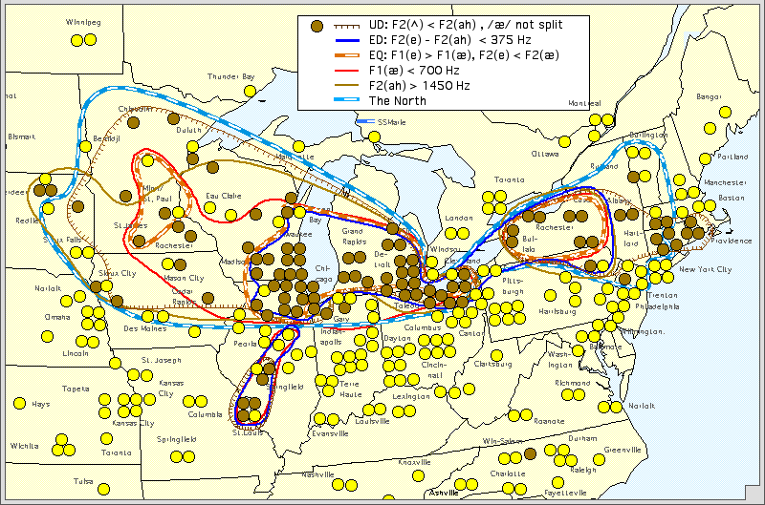
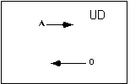
The UD measure of the Northern Cities Shift: cud is further back than cod

Slide 39
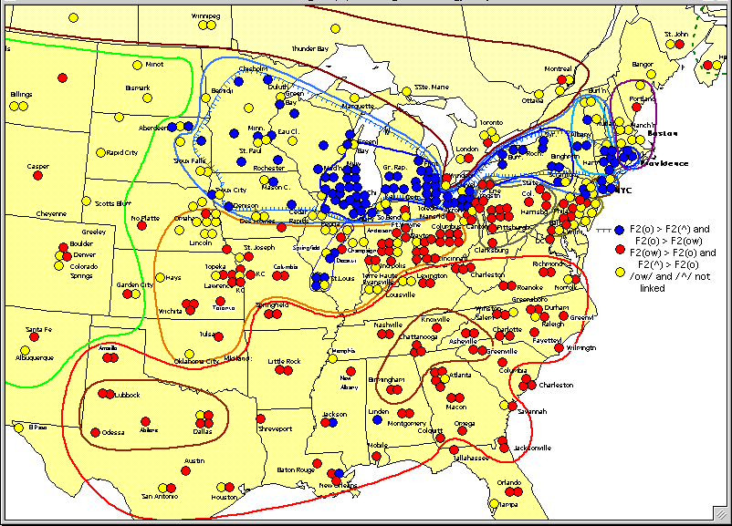
The North vs. the Midland and the South: cot, cut and coat

Slide 40
Enigmas of uniformity 6
The uniformity of AAVE grammar across the U.S.

Slide 41
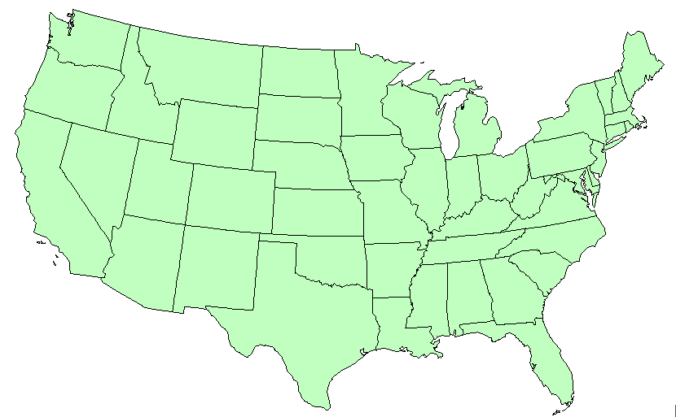
Some studies of AAVE across the U.S., 1966-2002
Morgan, Chicago 1980s
Wolfram, Detroit, 1969
Mitchell-Kernan, Berkeley 1966
Labov et al. NYC, 1966
Labov & Baker, S.F. Bay area, L.A., Philadelphia, Atlanta, 2000s
Labov,et al. Phila 1983
Rickford et al. E. Palo Alto 1991
Fasold,Wash. DC, 1972
Anne Charity Hudley, Cleveland, D.C., New Orelans, Richmond 2000s
Baugh, L.A., 1983
Bailey, Cukor-Avila, “Springville, “ 1991-
Weldon, Sea Islands,1990s
Summerlin. Gainesvillle, 1972
Carpenter, New Orleans, Memphis, Birmingham, 1990s

Slide 42
Domains of English grammar where AAVE and standard English are most different
Inflectional morphology
Tense/Mood/Aspect
Absence of standard English suffixes
Presence of unique features of AAVE
habitual be
preterit had
intensive perfective done
past perfective been done
resultative be done
remote perfect BIN
perseverative steady
indignative come
Variable absence
Invariant absence
Verbal -s He walks
Copula ‘s He’s here
Possessive -s John’s house
(Extensions of contraction)
(Absent in the underlying grammar)

Slide 43
Absence of /s/ in the spontaneous speech of elementary school children in Philadelphia by race. N=287.
John house He come He tired

Slide 44
Absence of three {s} inflections for North Philadelphia adults
--from S. Ash & J. Myhill 1986

Slide 45
Percent deletion of the copula and auxiliary is in four grammatical environments for eight studies of AAVE
He a doctor He here, He tired He talkin’ a lot He gonna go

Slide 46
Increase in had + past as a simple past over time: innovative had as a percent of past forms
Date of birth
Source: Cukor-Avila 1995

Slide 47
Observations on the use of the past perfect in the 1960s in South Harlem
At times, when a Standard English speaker would unhesitatingly use have, we find other members of the verbal paradigm appearing, and not always the same ones
  I was been in Detroit. [10, T-Birds, #498]
As far as the past perfect is concerned, there is no such variation. Pre-adolescent and pre-pre-adolescent speakers use the past perfect readily, with appropriate semantic force.
(213) How did the fight start?]
I had came over. . . [8, T-Birds, #983]
--Labov, Cohen and Robins 1968, Vol 1: 254.

Slide 48
Tyreke, age 7: asleep in his brother’s bed (Philadelphia, 2001)
I was sleep in my brother's bed, and when they's all downstairs, my whole family's downstairs with the cake ‘cuz, it's my birthday, then I HAD woke up, it was this monster, then I HAD got the Super Nintendo, hit him with the head, but that didn't work, then I ran downstairs, then I woke up.

Slide 49
Sharya, 8: the fight with a girl bigger than her (Philadelphia, 2001)
Well, I was like, at my grandma's house, and I went back home, cuz my mom, me and Sabrina was here, and then I went back home. And I said, "Sabrina, you got a rope that we can play with Sinquetta an’ em” and she HAD said "Yeah” so then Sinquetta and them had to go back in the house, la, la, la, blah, blah, blah, then some other big girl. We was playin' rope right, then she gon jump in and she say "You might jump better, and not be 'flicted." I said "It's not going to be ‘flicted, cuz I know how to turn." And then she only got up to ten. She was mad at me, and she HAD hit me, so I hit her right back. Sabrina jumped in it. And start hittin' her.

Slide 50
Enigma variations

Slide 51
Is uniformity the result of
Transmission Diffusion
Child learning Adult learning
Family tree model Wave model
A B C
A ) ) ) B ( ( ( C
Labov 2007

Slide 52
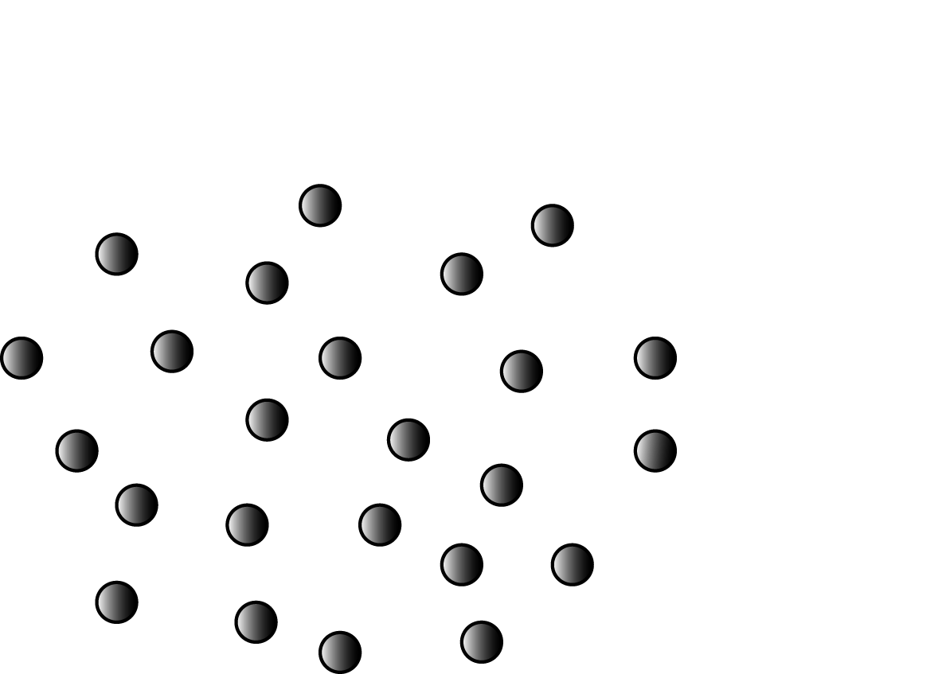
A uniform distribution

Slide 53
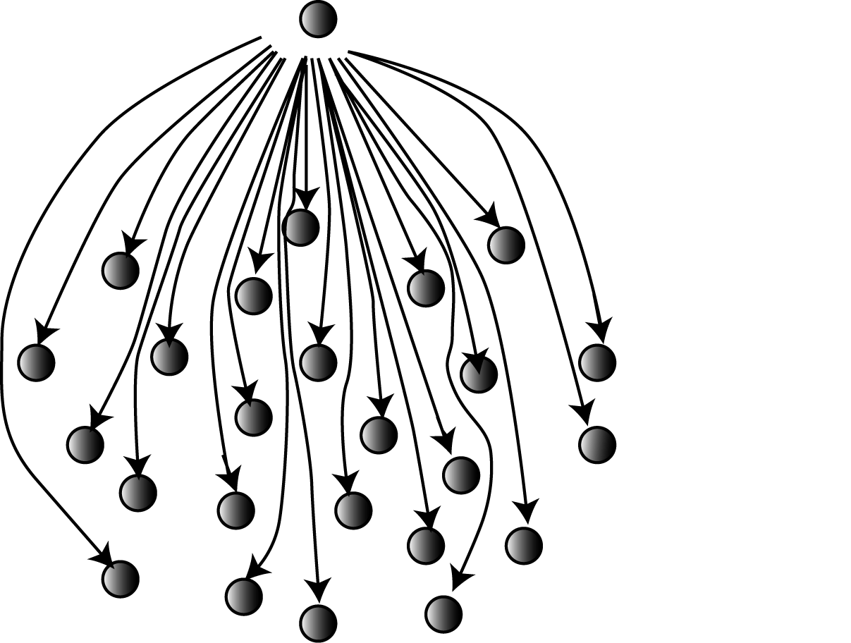
Uniformity through mass media

Slide 54
Strength of the norm: change in per cent R-lessness with “stardom” in movie role (A Star is Born, 1937 – 1976)
Janet Gaynor, 1937
FROM RHOTIC DIALECTS
Judy Garland, 1954
Barbra Streisand, 1976
FROM R-LESS DIALECT
“Struggling actress”
“After stardom”
-- from Elliott, Nancy C. 2000. Rhoticity in the Accents of American Film Actors: A Sociolinguistic Study. Standard Speech : Voice and Speech Review 2000, pp.103-130.

Slide 55
R-lessness of “good girls” and “bad girls”, 1944-1947
% R-less
Dvorak, Ann
Patrick, Gail
Hayworth, Rita
“bad girl” roles
Actresses from r-less dialects
“good girl” roles
-- from Elliott, Nancy C. 2000. Rhoticity in the Accents of American Film Actors: A Sociolinguistic Study. Standard Speech : Voice and Speech Review 2000, pp.103-130.

Slide 56
Percent r-lessness in actors’ film speech by decade
Actors from r-less regions
Actors from rhotic regions
Reversal of norm
Elliott, Nancy C. 2000. A sociolinguistic study of rhoticity in American film speech from the 1930s to the 1970s. Ph.D. dissertation, University of Indiana

Slide 57
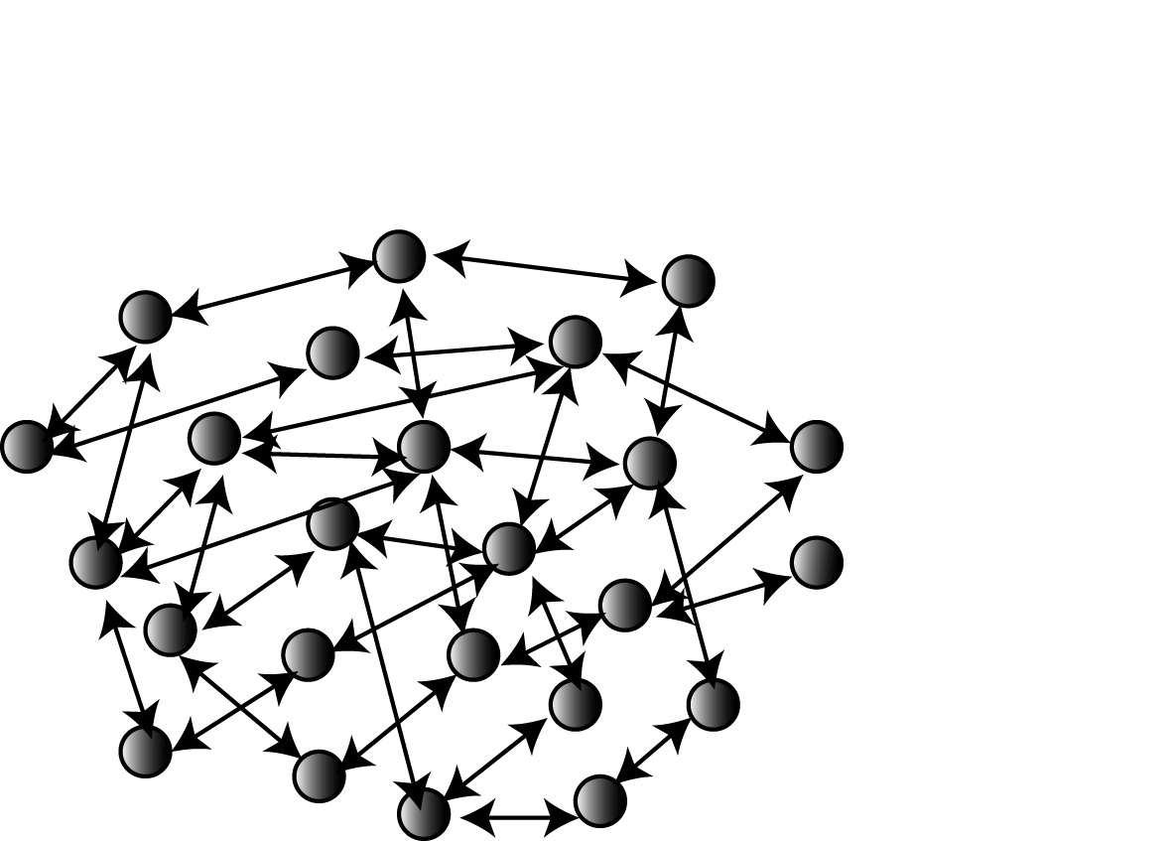
Uniformity through networking
Uniformity through global networking

Slide 58
The communication index C5
Combines answers to questions about the density of communication on the block:
How many people on the block do you
say hello to?
have coffee with?
ask for advice?. . .
with the proportion of friends who live off the block.

Slide 59
Scattergram of the fronting of (aw) by the communication index C5 for women in four Philadelphia neighborhoods

Slide 60
Fronting of (awc) by communicaton index

Slide 61
Sociometric position of Celeste S. in the Clark St. network
(Upper figure: advancement of change, lower figure, C5 index).

Slide 62
Percent of fashion leadership by status and gregariousness.
[Source: Katz and Lazarsfeld 1955: Table 32]
Status
Gregariousness High Middle Low
High 22% 36% 24%
Medium 31% 24% 17%
Low 21% 17% 11%

Slide 63
The two-step flow of communication
(Katz and Lazarsfeld, Personal Influence)

Slide 64
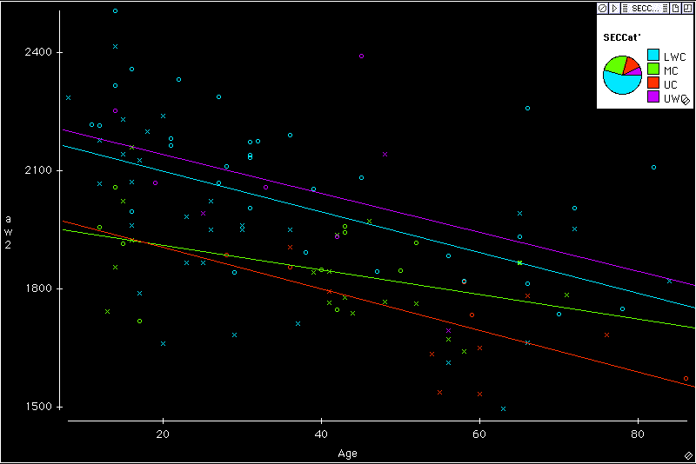
Two leaders of linguistic change in the fronting of (aw) for SEC in Philadelphia Neighborhood Study [N=112]
Teresa M.
Celeste S.

Slide 65
Parallels between the leaders of linguistic change and fashion leaders
1. The leaders are women; men play no significant role.
2. The highest concentration of leaders is in the groups centrally located in the socioeconomic hierarchy, that is, leadership forms a curvilinear pattern.
3. The leaders are people with intimate contacts throughout their local groups, who influence first people most like themselves.
4. The leaders are people who are not limited to their local networks, but have intimate friends in the wider neighborhood.
5. These wider contacts include people of different social statuses, so that influence spreads downward and upward from the central group.

Slide 66
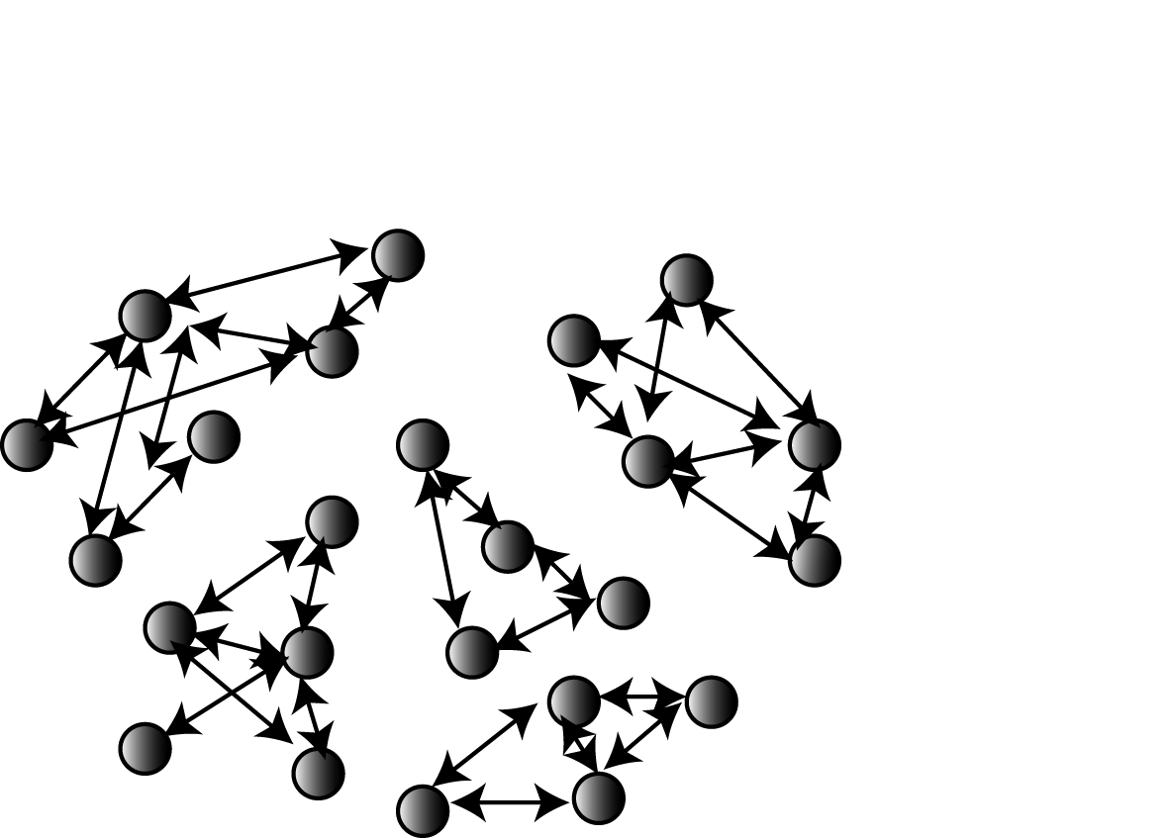
Local networks

Slide 67
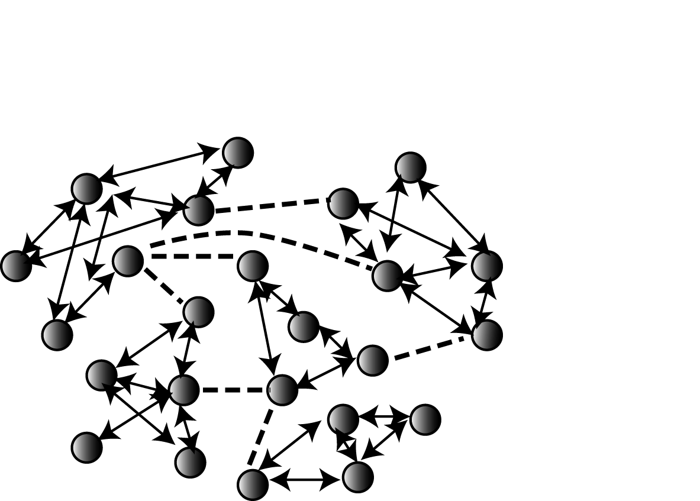
Local networks connected through weak ties

Slide 68
Is uniformity the result of
Transmission Diffusion
Child learning Adult learning
Family tree model Wave model
A B C
A ) ) ) B ( ( ( C
Labov 2007

Slide 69
Settlement patterns

Slide 70
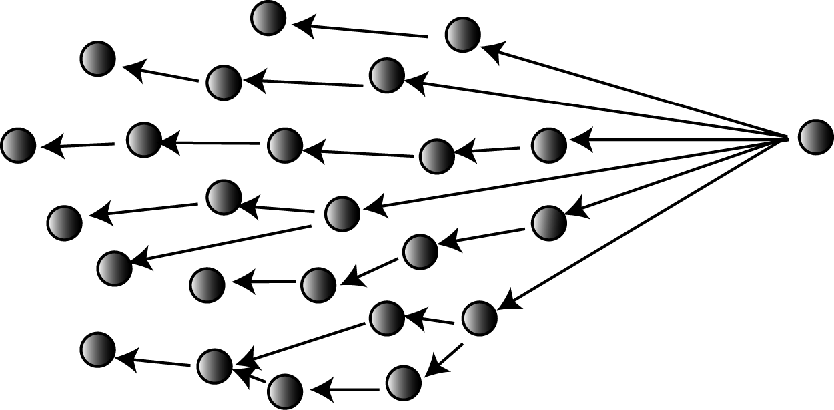
Uniformity from settlement patterns

Slide 71
Community movement in the migration from New England
Mass migrations were indeed congenial to the Puritan tradition. Whole parishes, parson and all, had sometimes migrated from Old England. Lois Kimball Mathews mentioned 22 colonies in Illinois alone, all of which originated in New England or in New York, most of them planted between 1830 and 1840.
--Richard L. Power, Planting Corn Belt Culture: The Impress of the Upland Southerner and Yankee in the old Northwest, 1953. P. 14.

Slide 72
The individual movement of the Upland Southerner settlement of the Midland
The Upland Southerners left behind a loose social structure of rural “neighborhoods” based on kinship; when Upland Southerners migrated--as individuals or in individual families--the neighborhood was left behind.
Tim Frazer, “Heartland” English., ed. T. Frazer, U. of Alabama Press, 1993. p. 63.

Slide 73
Migration patterns of Yankees and Midlanders
Yankee Midland/Upland South
Settlement Towns Isolated clusters
House location Roadside Creek & spring
Internal migration Low Very high
David Hackett Fischer 1989. Albion's Seed: Four British
Folkways in America. Oxford: Oxford University Press, p. 814.

Slide 74
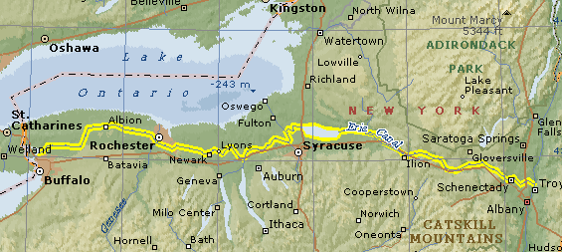
The Erie Canal, constructed 1817-1825
Notes:
Plan to open the west; beginning of NY rise. The canal: 1817-1825.

Slide 75
The impact of the Erie Canal
The impact on the rest of the State can be seen by looking at a modern map. With the exception of Binghamton and Elmira, every major city in New York falls along the trade route established by the Erie Canal, from New York City to Albany, through Schenectady, Utica and Syracuse, to Rochester and Buffalo. Nearly 80% of upstate New York's population lives within 25 miles of the Erie Canal.
The Erie Canal: A Brief History
No established village had ever mushroomed so rapidly [as Rochester], growing from 1507 to 9207 within a ten year span
- Blake McKelvey, A Panoramic View of Rochester History. Rochester History 11:2-24.

Slide 76
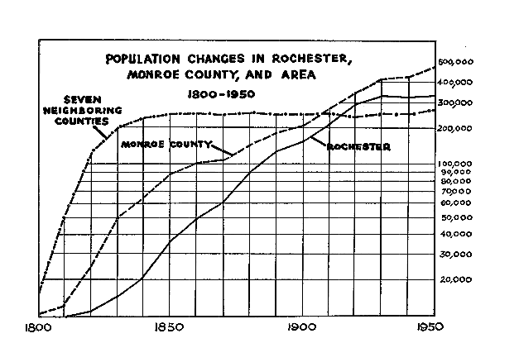
Growth of population along the Erie Canal
Erie canal
Notes:
Exponential growth of surrounding era.

Slide 77
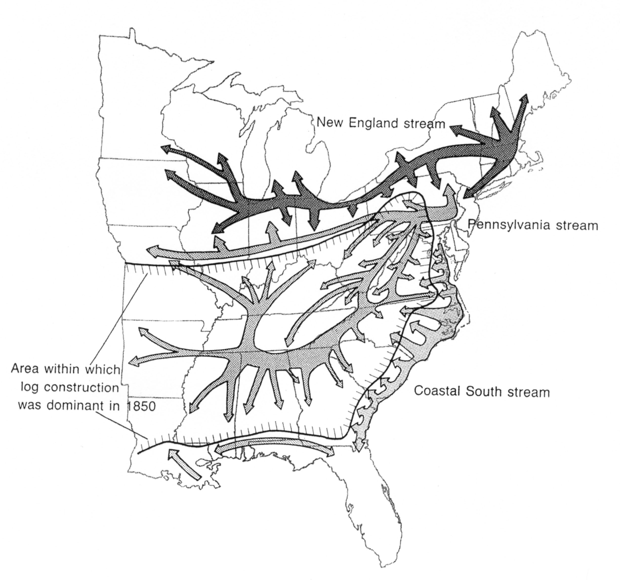
Settlement patterns, 1840-1860, as reflected in house construction
North
Midland
Upland South
Kniffen & Glassie 1966. Fig. 27

Slide 78
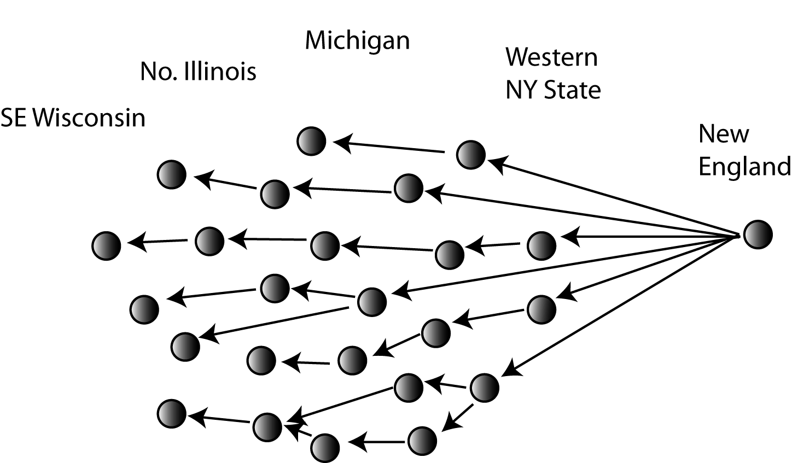
Uniformity from settlement patterns

Slide 79
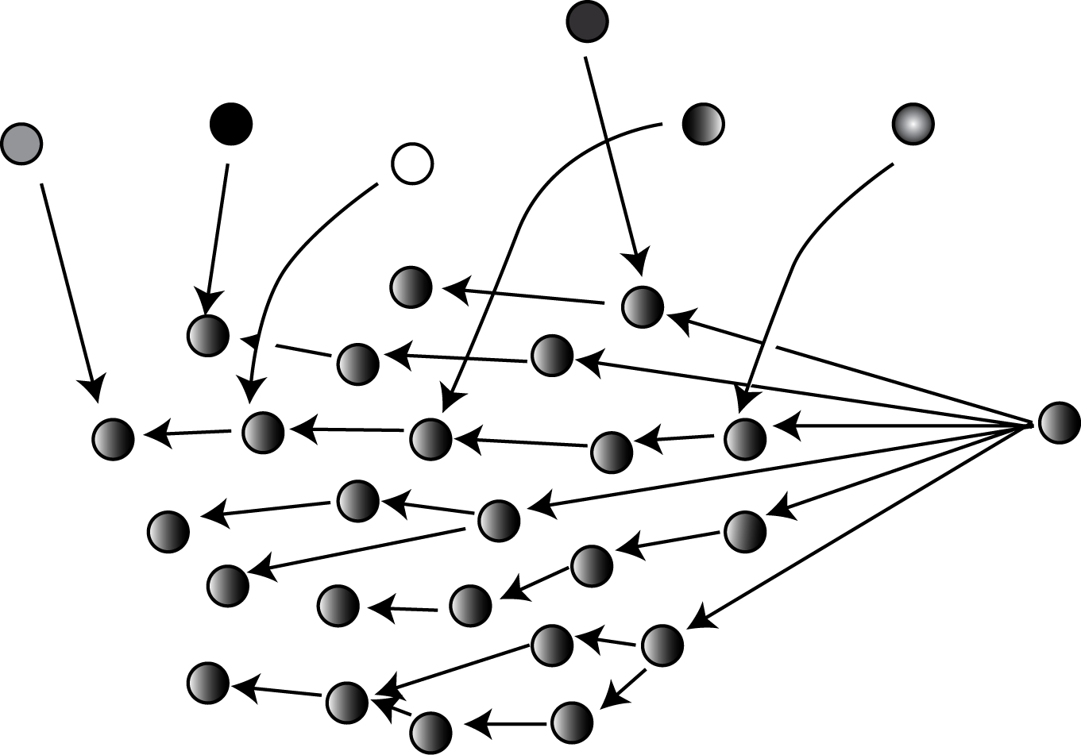
Inmigration absorbed by First Effective Settlement

Slide 80
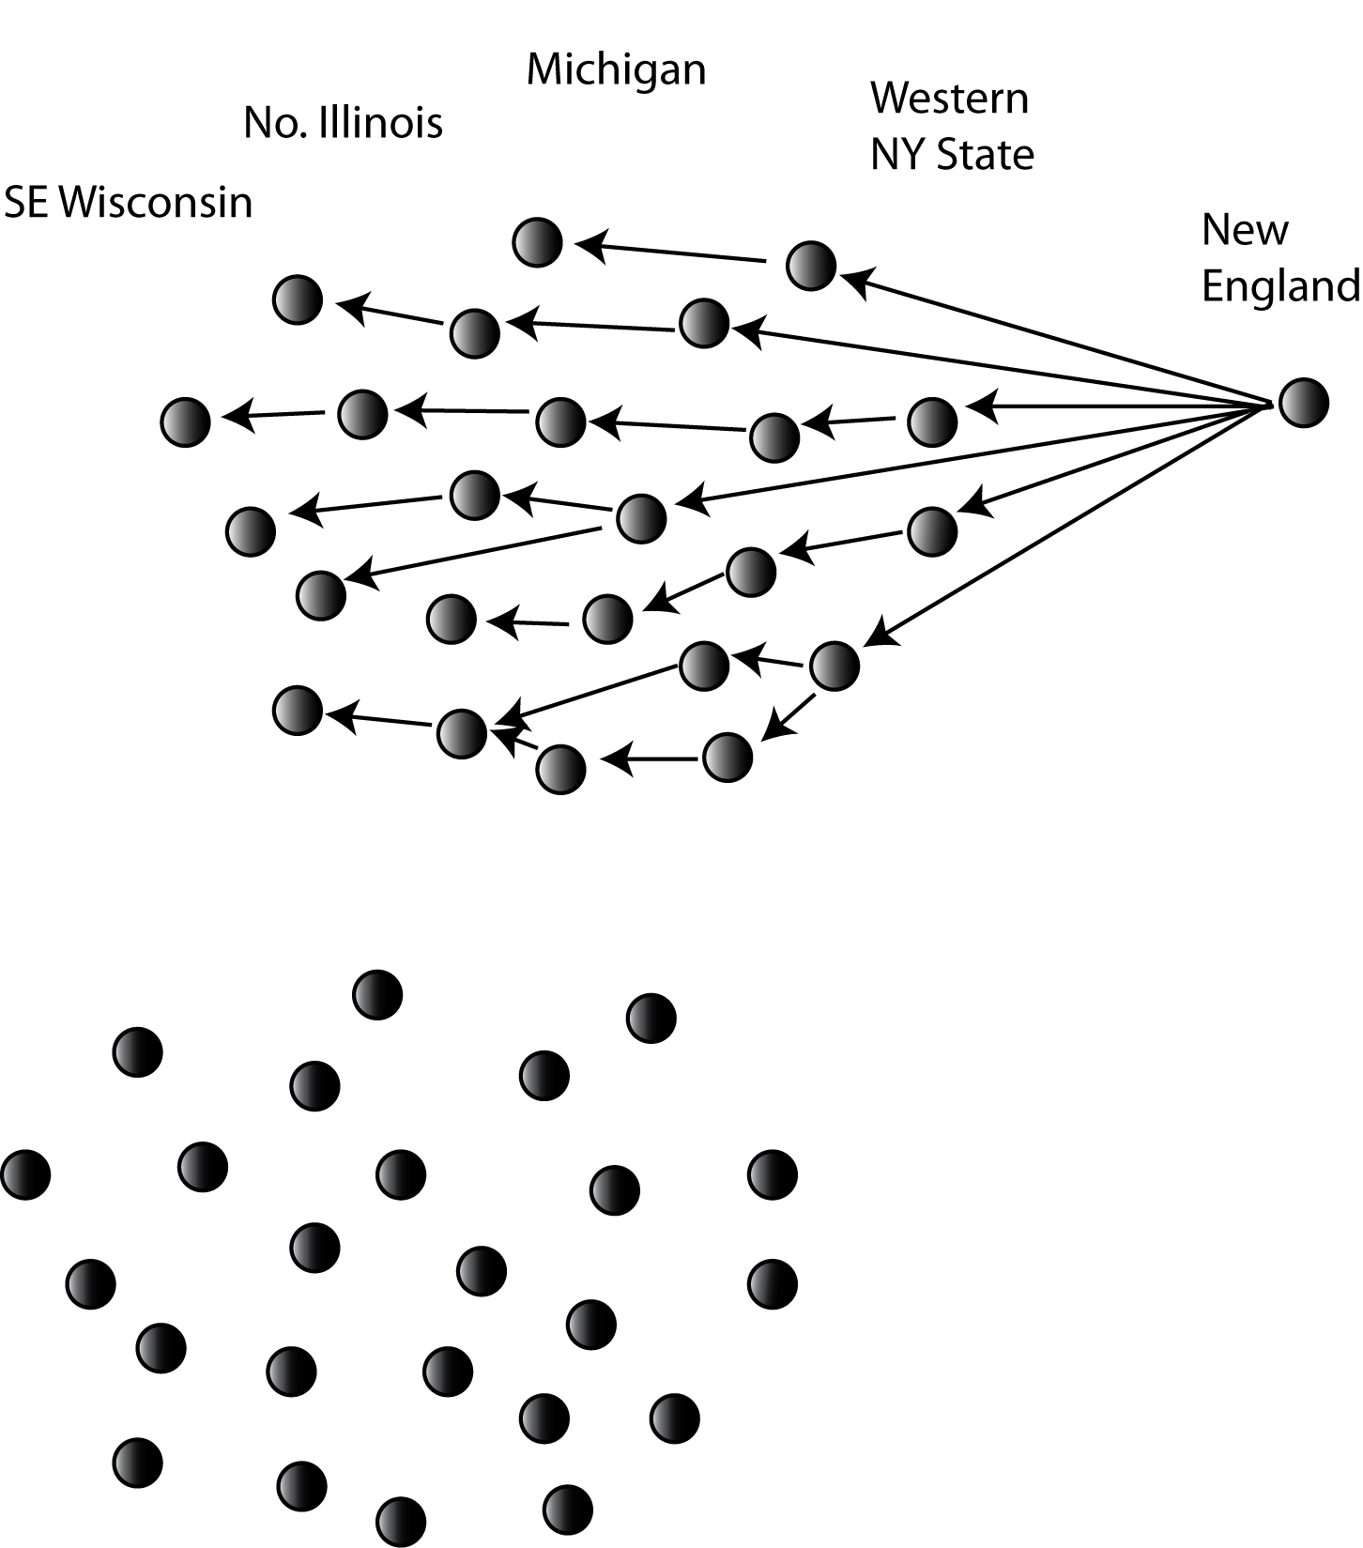
The effect of uniform principles of chain shifting

Slide 81
Area investigated for the stability of the cot-caught merger in Johnson 2007

Slide 82
Development of the cot-caught merger in three families in Seekonk, MA (Johnson 2007)

Slide 83
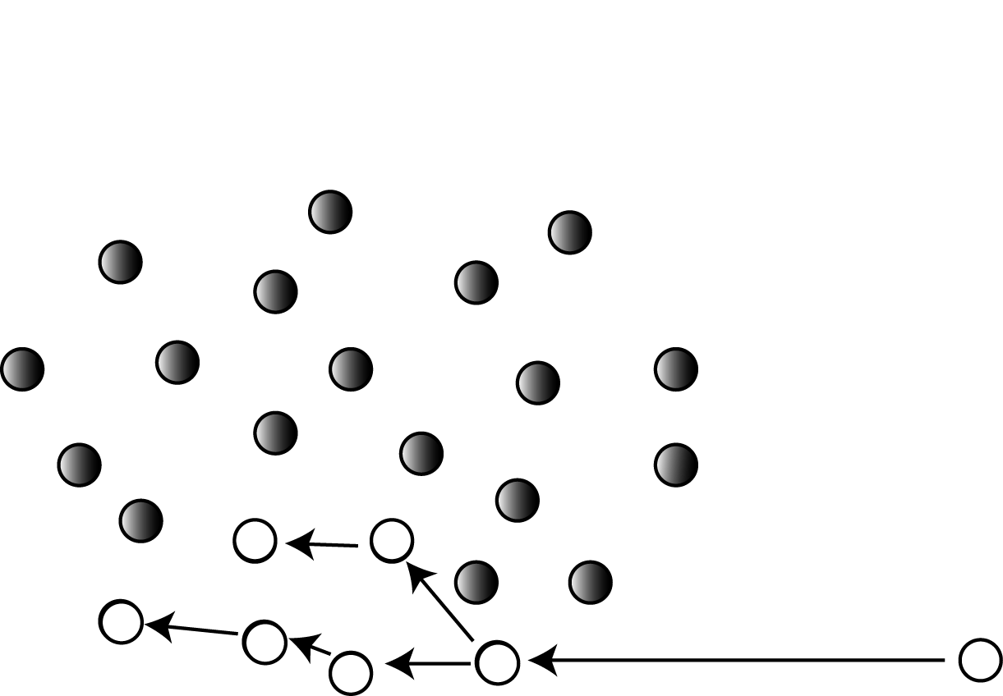
Inmigration of younger speakers

Slide 84
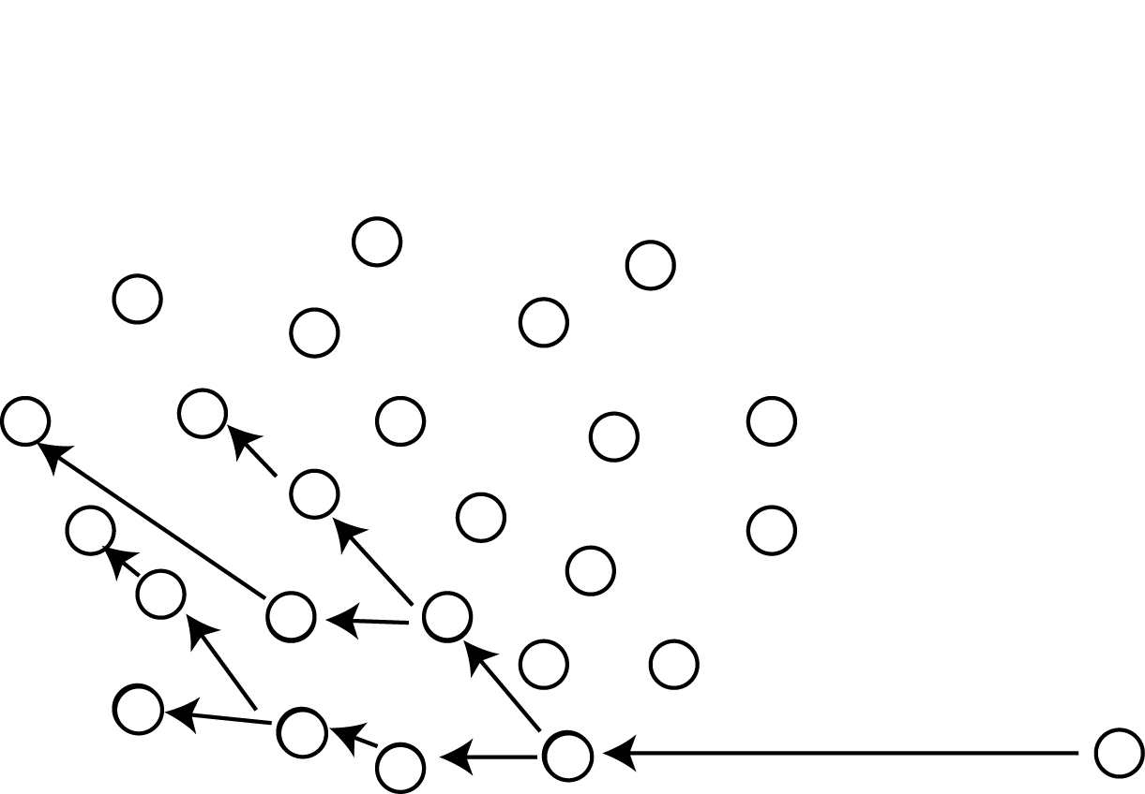
End result of further inmigration

Slide 85
www.ling.upenn.edu/labov
Principles of Linguistic change, Vol 3: Cognitive and Cultural Factors.
Ch 5 Triggering events
Ch 8 Driving forces
Ch 9 Divergence
Ch 10 The Northern Cities Shift and
Yankee Cultural Imperialism
Ch 12 Endpoints

Slide 87
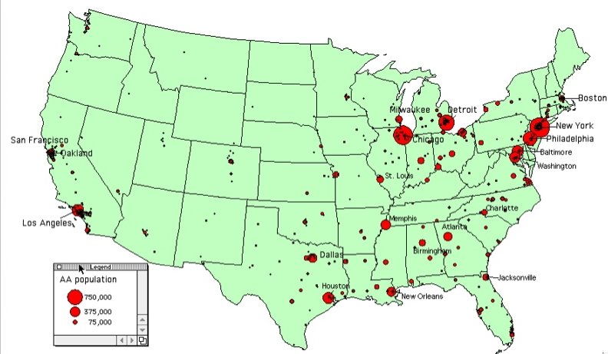
African American diaspora

Slide 88

R-less* areas in the 1950s (Pronunciation of English in the Atlantic States - PEAS) compared to the 1990s (Atlas of North American English - ANAE)
________
* “R-less”
= “R-vocalization”
= not pronouncing R after a vowel, e.g. “pahk the cah”
FDR
Hazel L., New York CIty
Dolly R., New York City & N. Carolina

